Slide 1

Submitted by:-
Ashutosh Mishra
Ratings Prediction Classifier

Slide 2




Introduction
Top Classification Model
Defaulter Prediction
Conclusion
Background and Approach

Slide 3




Introduction -
This research project was for one of our client who has a website where people write different reviews for technical products. Now they want us to predict the ratings for the reviews which were written in the past and don’t have a ratings initially.
Libraries Explored
Motivation Behind
Statistics, Analytical Modelling
Hyper Tuning Method
CV Score
Predictive Modelling and Classification Model, etc.
Develop a holistic understanding like – use of statistics, data visualizations, analysis based on past data for better and accurate prediction, etc.
Objective
Illustration
Project comprises of six different test cases where the objective was to train and test for accuracy score and different classification reports using CV Score to check the accuracy of the different algorithms model
Count Chart
Pearson Correlation Heat map
Distribution and Box Plot
Pair Plot
Violin Plot

Slide 4
Background and Approach -
Classification Models
Model
Graphs
As, we know that after Covid pandemic most of the industries are trying to overcome their business challenges; so does our client is. This research project was for a client who has a website where people write different reviews for technical products. Now they are adding a new feature to their website i.e. The reviewer will have to add ratings as well with the review.
Predictive modelling, Market mix modelling, recommendation systems are some of the machine learning techniques globally used for achieving the business goals for such traders.
Currently the assigned project utilizes Predictive Modelling algorithm to solve the business statement.
Predictive Modelling
Analytical Modelling
CV Score
Scikit Learn Libraries
Classification Modelling
Hyper Tuning Method
Grid Search CV

Slide 5
Top Classification Models
Classification Models | Testing Accuracy (in %)
Random Forest Regressor | 61
K Neighbors Classifier | 46
Support Vector Classifier | 28
Decision Tree Classifier | 59
Ada Boost Classifier | 25
Gradient Boosting Classifier | 33

Slide 6
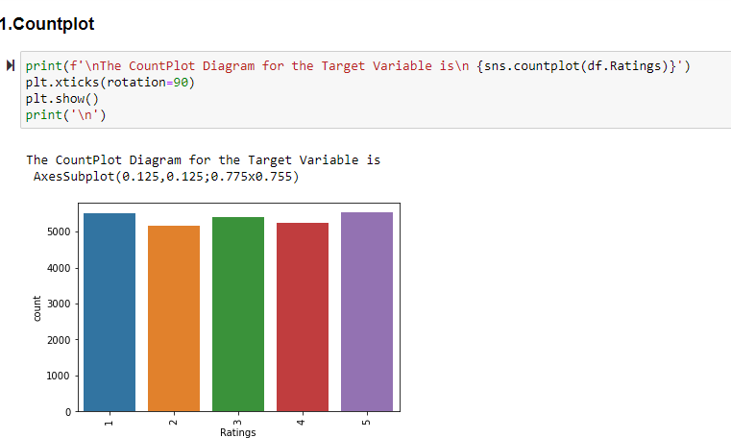
Data Visualization

Slide 7
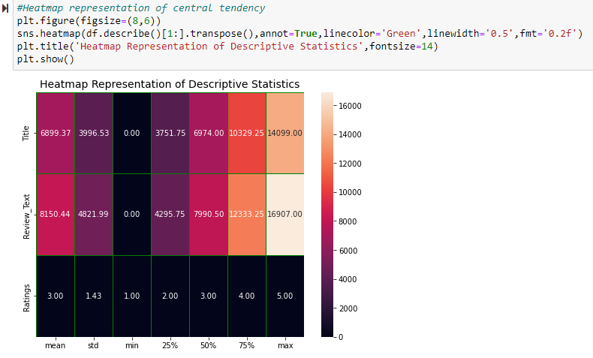
Data Visualization

Slide 8
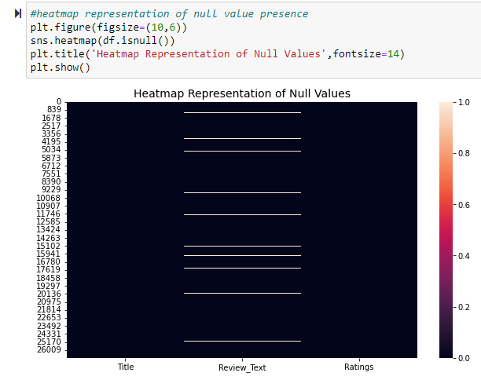
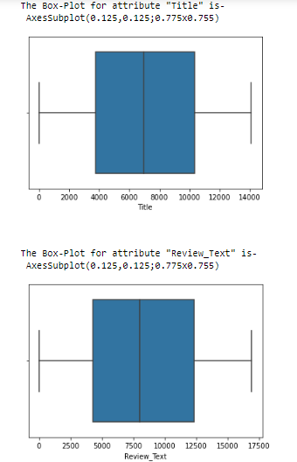
Data Visualization

Slide 9
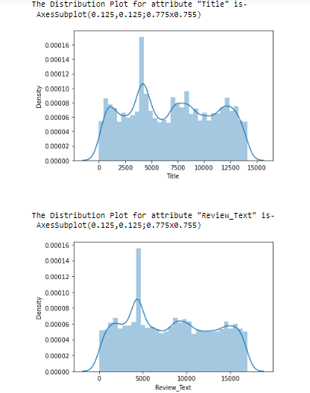
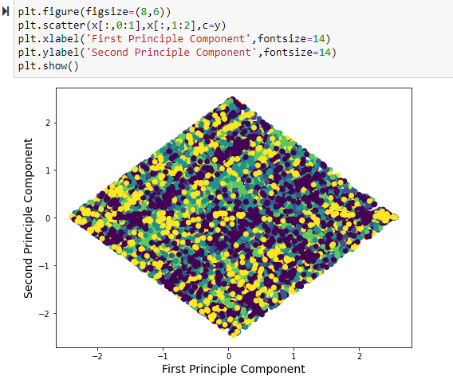
Data Visualization

Slide 10
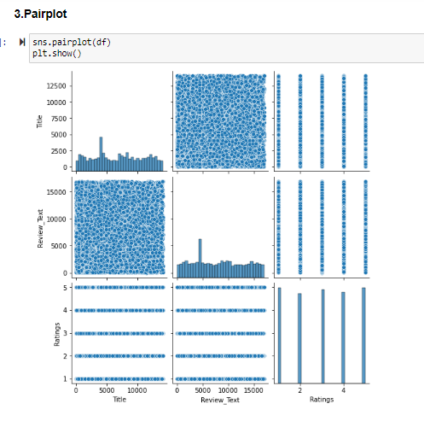
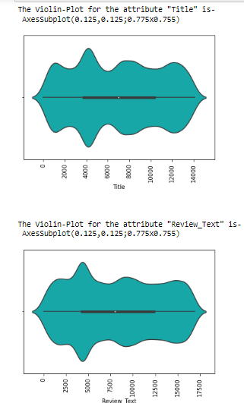
Data Visualization

Slide 11
Interpretation of the Results
Below are some of the point’s w.r.t. visualization, pre-processing presented above -
Null values are present in two of the columns and the null value counts is 706
In this dataset rating of 5 is on top having 5527 rows out of 26840 rows
11040 rows are present having rating 1 or 5 all-together
10923 rows are present having rating 3 or 5 all-together
10767 rows are present having rating greater than 3 or rating is equal to 5 all-together
No strong skewness present in the dataset
No outliers are there in this dataset

Slide 12
Challenges Faced
One of the key challenge that I faced was scraping the data from different websites like Flipkart and Amazon as it was very time taking while looking for outputs and several time I was getting exceptions error and it restricted me to go with only one website that’s why I scraped the data from one Amazon only.

Slide 13
Conclusion -
After comparing all the above model I come to the point that Random Forest Classifier model performs well as compare to other models. This model generates training accuracy as almost 100% and testing accuracy as 61% which is best as compare to others. Also the Cross Validation score for the model is increasing at each instances so we can say that it might come same as that of testing accuracy at some point.

Slide 14


Thank You !
Ashutosh Mishra
ashutoshmishra11@outlook.com

